Slide 1
Software Foundations of Security and Privacy (15-316, spring 2016) Lecture 2: Building Safe Systems
Jean Yang
jyang2@andrew.cmu.edu

Slide 2
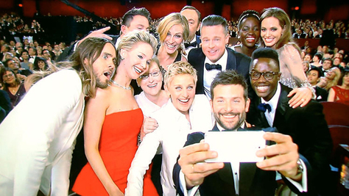
This lecture: celebrities and the Internet
Selfie from the 2014 Oscars that was retweeted over one million times and caused a Twitter outage.

Slide 3
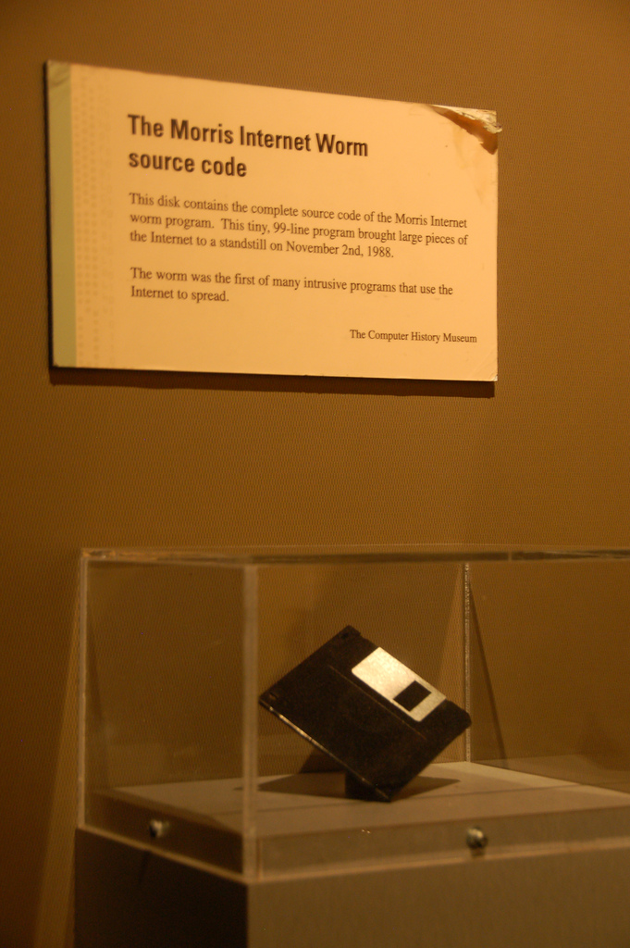
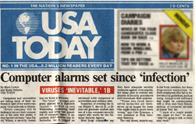
Before photos broke the Internet…
The first “celebrity bug:” Morris Worm, November 1988.

Slide 4
Bug: Morris Worm
Launched November 2, 1988 from MIT.
One of the first worms distributed on the internet, and the first celebrity worm.
Resulted in first felony conviction, under the 1986 Computer Fraud and Abuse Act.
Named after its creator, Cornell University graduate student Robert Morris.

Slide 5
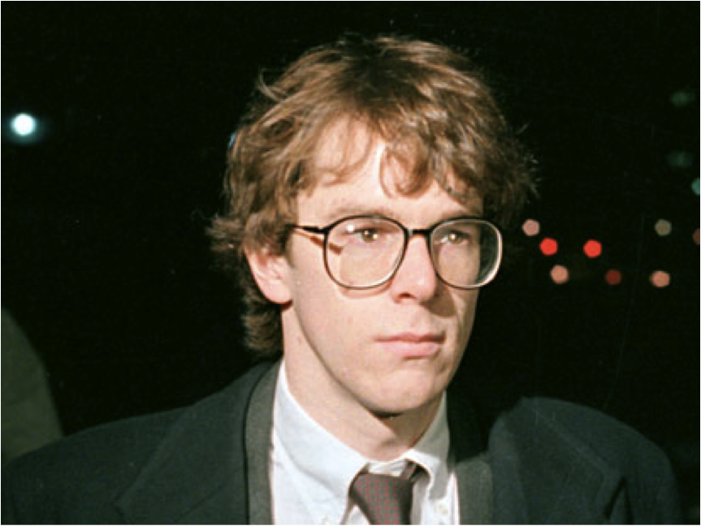
Innocent intentions
Supposedly intended to gauge the size of the Internet.
Exploited known vulnerabilities in Unix commands.
Flaw (or was it?) in design caused program to spread very rapidly.
Photo of Robert Morris, now a tenured professor at MIT (and my good friend’s PhD thesis advisor)

Slide 6
Fallout
The estimated damage was $100k to $10,000k.
People estimated the worm affected 10% of the 60k computers on the internet.
Internet was partitioned for several days while people cleaned up their networks.
DARPA funded founding of CERT/CC at CMU.
Robert Morris was sentenced to three years probation, 400 hours of community service, and fined over $10k.

Slide 7

Bug: Heartbleed
Vulnerability in the OpenSSL cryptographic library, introduced in 2012 and announced April 2014.
Allows anyone from the Internet to access the protected memory.

Slide 8
What Heartbleed did
Allows attackers to eavesdrop on communications, steal data, and impersonate services and users—all without a trace.
Users’ session cookies, passwords, and more became vulnerable.
Solutions included patching the vulnerability, changing your password, and staying away from the Internet.

Slide 9
Fallout
“Some might argue that Heartbleed is the worst vulnerability found (at least in terms of its potential impact) since commercial traffic began to flow on the Internet.” –Joseph Steinberg, Forbes
“If you need strong anonymity or privacy on the Internet, you might want to stay away from the Internet entirely for the next few days while things settle.” –Tor project

Slide 10
Fallout
At the time of disclosure, 17% (around half a million) of the Internet’s secure web servers were believed to be vulnerable.
As of May 20, 2014, 1.5% of the 800,000 most popular TLS-enabled websites were still vulnerable.
eWEEK estimates $500 million as a starting point for the cost. For example, Heartbleed enabled hackers to steal security keys from Community Health Systems, the second-biggest for-profit hospital chain in the United States, compromising the confidentiality of 4.5 million patient records.

Slide 11
What went wrong?

Slide 12

We want memory to be everything
Numbers!
Code!
Addresses!

Slide 13

But memory is just memory

Slide 14
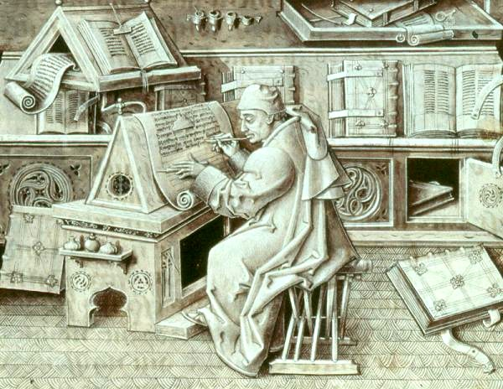
Managing memory requires care

Slide 15
Mixing memories: buffer overflows
Programs expect inputs (often strings) to be of a certain size.
Giving programs inputs of larger size usually causes them to crash.
A buffer overflow exploit involves “taking over” programs by giving programs inputs of larger size.
Borrowed heavily from https://courses.cs.washington.edu/courses/cse451/05sp/.../overflow1.ppt

Slide 16
Background: C call stacks
When a function call is made, the return address is put on the stack.
Often the values of parameters are put on the stack.
Usually the function saves the stack frame pointer (on the stack).
Local variables are on the stack.
Borrowed heavily from https://courses.cs.washington.edu/courses/cse451/05sp/.../overflow1.ppt

Slide 17
Background: stack frames
high
Parameters
Return Address
Calling Stack Pointer
Local Variables
SP+offset
SP
Addresses
00000000
low
Borrowed heavily from https://courses.cs.washington.edu/courses/cse451/05sp/.../overflow1.ppt

Slide 18
Background: example stack
18
addressof(y=3) return address
saved stack pointer
y
x
buf
x=2;
foo(18);
y=3;
void foo(int j) {
int x,y;
char buf[100];
x=j;
…
}

Slide 19
Buffer overflows, more specifically…
General idea is to overflow a buffer so that it overwrites the return address.
When the function is done it will jump to whatever address is on the stack.
We put some code in the buffer and set the return address to point to it!
Borrowed heavily from https://courses.cs.washington.edu/courses/cse451/05sp/.../overflow1.ppt

Slide 20
Example of buffer overflow
void foo(char *s) {
char buf[10];
strcpy(buf,s);
printf(“buf is %s\n”,s);
}
…
foo(“thisstringistoolongforfoo”);
Borrowed heavily from https://courses.cs.washington.edu/courses/cse451/05sp/.../overflow1.ppt

Slide 21
Morris Worm, a buffer overflow
Buffer overflow attacking gets() in fingerd.
fingerd declares a 512-byte buffer to be used by gets() without bounds checking. The buffer is the first local variable.
Attack inserted a 400-byte NOP sled that ended with a call to execve(“/bin/sh”,0,0), opening a shell and receiving instructions across the network.

Slide 22
Heartbleed: the opposite
In TLS, heartbeat requests keep a connection open by exchanging information back and forth. The requester specifies the size of the “payload,” and the server sends it back.
In vulnerable implementations, setting payload size to something bigger than it is makes the server send back arbitrary information!
Instead of writing out-of-bounds code to a buffer, Heartbleed reads nearby out-of-bounds memory.

Slide 23
What we’re not going to talk about
The Morris Worm only harmed the computers it infected, and also made people start taking computer security seriously. Should hacks of this nature be considered criminal?
The Morris Worm did not steal documents, distribute spam, or aid terrorism. Why did people get so upset? What are the risks of doing this kind of hacking?

Slide 24
What we are going to talk about
Tools and frameworks for reasoning about these vast seas of memory.
How to specify and verify correctness to rule out memory bugs.
How using safe languages to produce programs that are safe by construction.

Slide 25
Why security is a correctness problem

Slide 26
What we want need*
Buffers have their bounds checked!
Data is data, and not contain random code.
People can’t just randomly insert code when they are supposed to be giving us data values.
Secret theme of class: we need to demand more of our software!

Slide 27
What is safety?
← All or nothing!
Nothing bad happens.
The toaster does not burn down the house.
Only people within the house can operate the toaster.
Uber does not leak information about locations and credit card numbers.
Uber does not allow data scientists to infer individual locations.

Slide 28
Safety and security
Safety: protecting a system from accidental failures.
Security: protecting a system from active attackers
Safety is required for security!

Slide 29
Memory safety
Memory access errors do not occur:
buffer overflow
null pointer dereference
use after free
use of uninitialized memory
illegal free (of an already-freed pointer, or a non-malloced pointer)

Slide 30
Type safety
The programming language ensures that there are no discrepancies between the stated type of a value and the actual type.
Example of something unsafe: Booleans are integers in C.
Often strictly stronger than memory safety.

Slide 31
Liveness is a different thing
A liveness property states that something good eventually happens.
Toaster eventually produces sufficiently cooked toast.
Uber eventually gets you where you need to go.
This course eventually teaches you everything about constructive security.

Slide 32
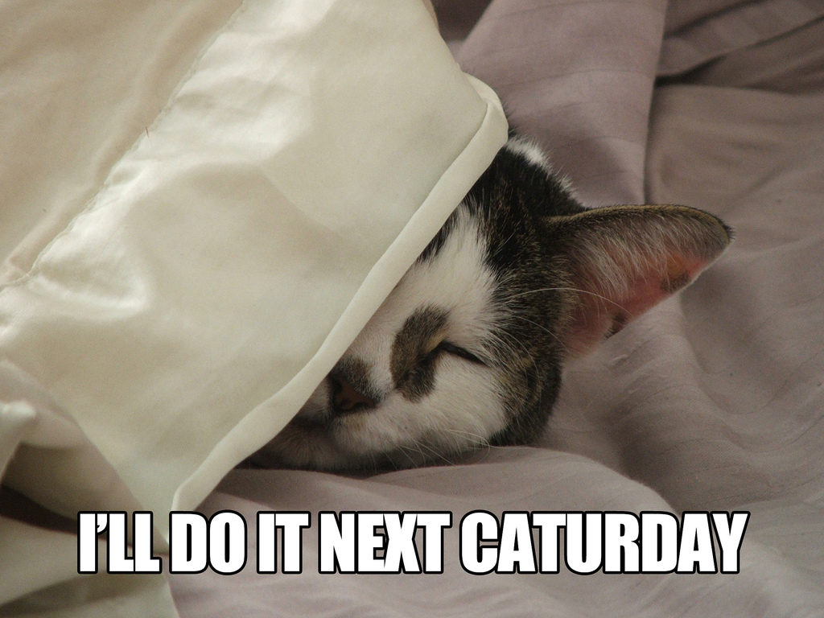
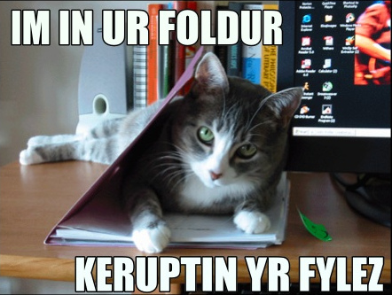
Need both safety and liveness
Only safety
Only liveness

Slide 33
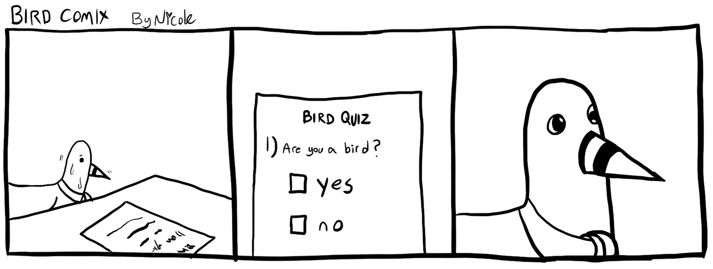
Quiz time!

Slide 34
How safe languages can help

Slide 35
Cowboy programming looks cool

Slide 36
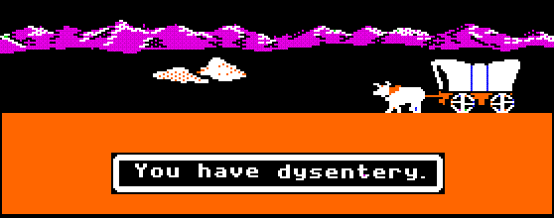
But often, in the Wild West…

Slide 37
Getting these guarantees in unsafe languages
Programming very, very carefully.
Writing myriad tests with good coverage.
Verifying the correctness of the code.
Fully automated techniques.
Interactive techniques.

Slide 38

On the other hand…
Safe language provide guarantees about every program written in the language.

Slide 39
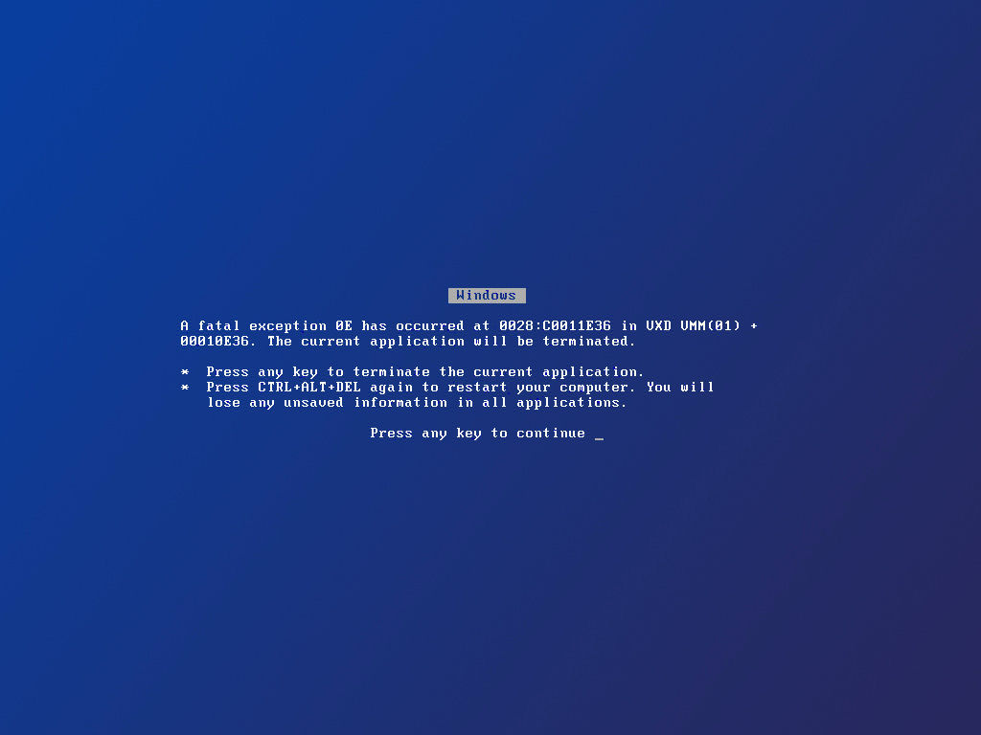
Case study: type-safe OSes

Slide 40
What if we used a safe language to build an OS?
Type-checked OS
Applications
Drivers
File System
Microkernel
Untyped
Unsafe code
(GC, stacks, drivers, …)
Hardware
Notes:
Projects such as Singularity and SPIN have taken the approach of writing operating systems in safe languages, with the reasoning that it is important for operating systems to be correct, but it is difficult to fully verify them because they are so large and complex.
All safe languages have a runtime system, however, and this runtime system contains unsafe code.
We are crossing our fingers that this code will not inappropriately access memory, but a bug here can completely subvert our typing guarantees.
Make it clear what the problems are with having the unsafe code.
Make it clear what we are going to verify. [Animate appear.]
Make it clear only hardware instructions are part of the trusted computing base.
TRANSITION: We propose a system design that can give you end-to-end guarantees of type safety.

Slide 41
Wanted: end-to-end type safety
Type-checked OS
Applications
Drivers
File System
Microkernel
Untyped
Unsafe code
(GC, stacks, drivers, …)
Verified code
(GC, stacks, drivers, …)
Hardware
Notes:
Projects such as Singularity and SPIN have taken the approach of writing operating systems in safe languages, with the reasoning that it is important for operating systems to be correct, but it is difficult to fully verify them because they are so large and complex.
All safe languages have a runtime system, however, and this runtime system contains unsafe code.
We are crossing our fingers that this code will not inappropriately access memory, but a bug here can completely subvert our typing guarantees.
Make it clear what the problems are with having the unsafe code.
Make it clear what we are going to verify. [Animate appear.]
Make it clear only hardware instructions are part of the trusted computing base.
TRANSITION: We propose a system design that can give you end-to-end guarantees of type safety.

Slide 42
Verve, a type-safe OS [Yang & Hawblitzel, 2009]
Type-checked
Verify partial correctness of low-level Nucleus using Hoare logic based on a hardware spec.
Verify an interface to typed assembly for end-to-end safety.
Applications
Drivers
File System
Microkernel
Verified
Interface specification
Nucleus
Hardware specification
Notes:
We present Verve, an operating system where every assembly instruction in the software stack is mechanically verified for type safety.
At the core of Verve is the Nucleus, which contains the low-level functionality that cannot be expressed within the type system of our safe language
We verify partial correctness properties of the Nucleus using Hoare logic with respect to a specification of device interfaces and assembly instructions.
We hoist the rest of the system, the kernel and applications, into managed C# code we compile to typed assembly. We verify that the low-level code and the managed code interact in a type-safe manner.
TRANSITION: Let us take a closer look at the Verve Nucleus..

Slide 43
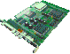

The Verve Nucleus
Type-checked
Verified
Applications
Interface specification
Interface specification
Drivers
File System
GC Heap
Interrupt table
Microkernel
Interrupt/error handling
Allocator and GC
[POPL 2009]
Verified
Interface specification
Stacks
Nucleus
x86 instructions
Memory bounds
Devices
Hardware specification
Notes:
The biggest component of our Nucleus is the allocator and garbage collector. We have integrated both the copying and mark-sweep collectors that Hawblitzel and Petrank described their 2009 POPL paper.
The Nucleus also describes the thread context stacks and handles context switching.
The Nucleus exports access to devices such as the screen, keyboard, and timer.
Additionally the Nucleus contains functionality for error and interrupt handling.
The nucleus sits on top of a trusted hardware specification of absolute x86 instructions, memory bounds, and device interfaces.
We verify the partial correctness of Nucleus code. For instance, we verify that we restore the appropriate observed registers when switching back to a context, that the garbage-collected heap to be well-formed, and that thread contexts are pushed onto the stack correctly when there is an interrupt.
Another goal of our verification was to ensure that the low-level code interacts properly with the typed-checked code. Specifically, we verify that the low-level code does not interfere with well-formedness of the garbage-collected heap and that the managed code does not interfere with thread context memory.
The rest of the data structures used by the scheduler are implemented in C#. In the type-checked kernel we have, for example, the ready queue, the GC queue, and the semaphore queues.
TRANSITION: We have written Nucleus invariants in Boogie.

Slide 44
Thread Context Invariant
function StateInv
(s:StackID, state:StackState, …)
returns(bool) {
(!IsEmpty(state) → … && (IsInterrupted(state) → …
&& (IsYielded(state) → …
&& state == StackYielded(
StackEbp(s, tMems)
, StackEsp(s, tMems) + 4
, StackRA(s, tMems, fMems)) && …
}
Notes:
Here we show an invariant that has the goal of describing what it means to be a well-formed thread context for the purpose of allowing us to define what it means to context switch back to an “appropriate” context.
This is a Boogie function, which is mathematical function in that it express relationships between values. I have shown all functions in light green.
This function takes as arguments an identifier ‘s’ specifying the context and a description “state” of the stack state. It also references global variables tMems and fMems, which are mathematical maps used to model the memory.
This invariant says that state must match what we have stored in memory for the context s and that the state should adhere to certain properties depending on whether it is not empty, interrupted, or yielded.
If the stack has yielded, one of the properties that should hold is that we have captured the frame pointer, the stack pointer, and the return address.
TRANSITION: We use invariants such as this one to specify the partial correctness of our Nucleus code, and also to provide trusted specifications of hardware instructions and device interfaces.

Slide 45
“Load” Specification
procedure Load(ptr:int)
returns (val:int);
requires memAddr(ptr);
requires Aligned(ptr);
modifies Eip;
ensures word(val);
ensures val == Mem[ptr];
Notes:
For instance, here is specification for the load instruction, which takes a pointer to a memory address and returns the value in memory at that location.
We have the post-conditions that we have a 32-bit word and that the result matches the memory value at that location.
Note that we need to ensure that the result is a word because Boogie has mathematical integers.
In order to be able to call the Load instruction, we need to also satisfy the precondition that the address we have is in bounds and that it is 4-byte aligned.
Our specification also declares that we modify the instruction pointer eip.
Thus any procedure that calls load can use these postconditions, but they must satisfy the preconditions and cannot make any assumptions about the value of the instruction pointer afterward.
TRANSITION: Our Nucleus consists of Boogie procedures using these specifications.

Slide 46

Verve vs. SeL4?
Applications
Drivers
File System
120-240 person-months
SeL4
Verified microkernel
8,700 lines of C
Verve
C# kernel
Verified Nucleus
~1500 lines of x86
~600 lines ARM assembly
200,000 lines of Isabelle
20x code
Notes:
SeL4 verifies the L4 microkernel and presents an approach for verifying the correctness of a large body of low-level code. SeL4 consist of 8700 lines of C verified to be equivalent to a Haskell reference implementation, which is verified to satisfy properties specified in the Isabelle theorem prover.
The kernel interfaces with 600 lines of trusted ARM assembly.
[Compare to Verve.]
The verification takes 200,000 lines of proof script in the Isabelle interactive prover, which is 30 times the size of the code. It also took the team 10-20 man-years.
TRANSITION: While SeL4 presents and impressive verification achievement, we are presenting a much lighter-weight approach to verifying important system properties. Verve also verifies the whole system, relying on no lines of trusted assembly.

Slide 47
Takeaways
Safety is an important property for security. Low-level languages like C are unsafe, so we have to be careful!
Using types gives us lightweight way of getting safety.
We can even get type safety in systems with low-level code, but this requires us to do some more heavyweight verification.

Slide 48
Assignment 1 is coming out!
Will go out later today. We’ll announce over Piazza.
Task: implement an OCaml data server with a basic security policy.
Develop a test suite to check compliance with the spec.
Due in 2 weeks: 2/2/17.

Slide 49
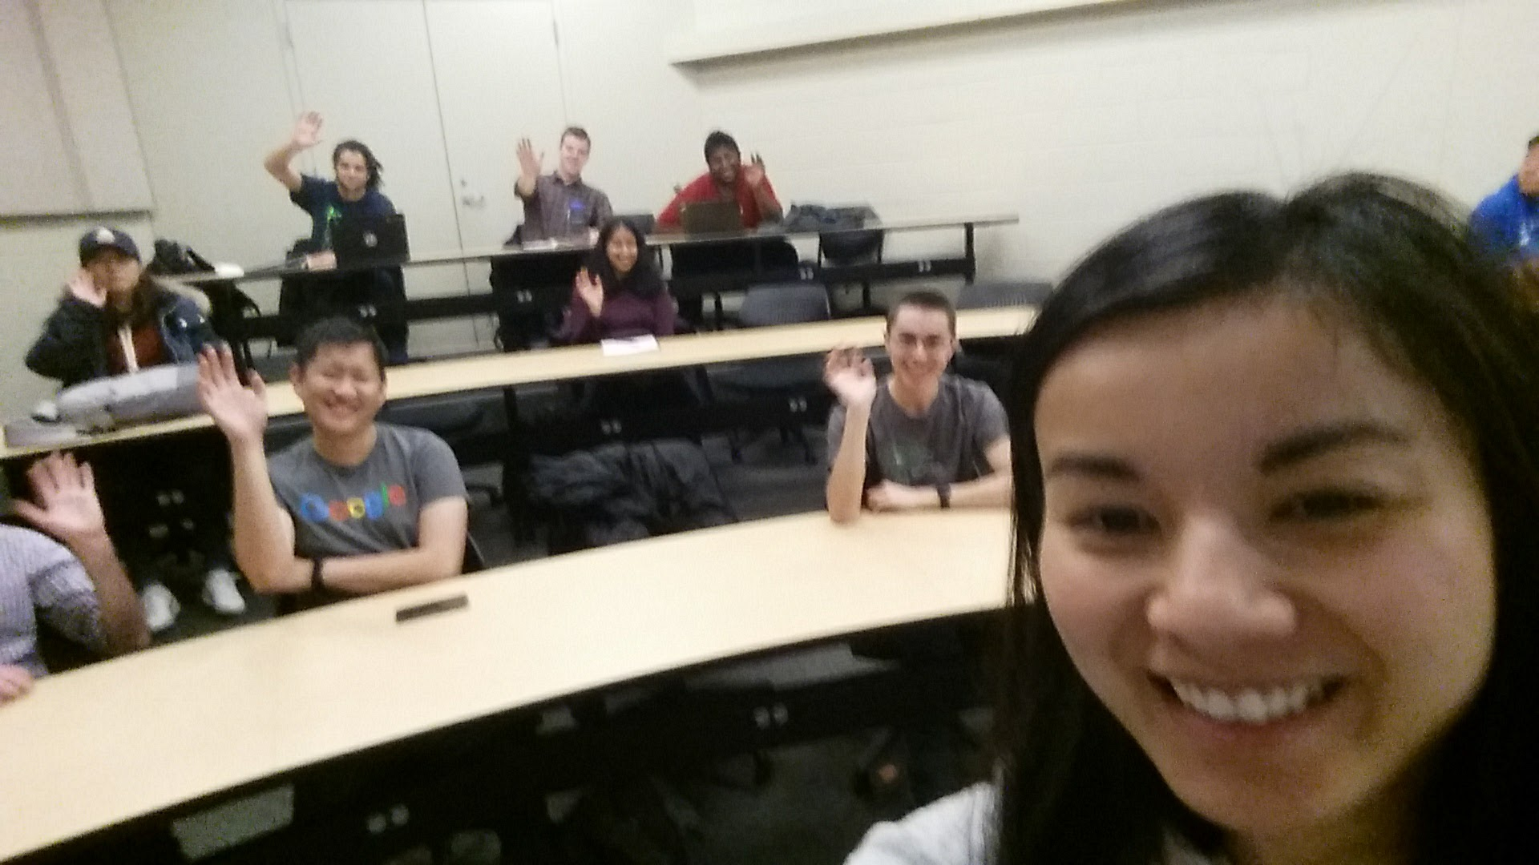
Selfie from beginning of class, and answer to quiz question #1

